Slide 1



Design
Thinking
E-Workbook
For Entrepreneurship Development (2HS309) Course

Slide 2


Instructions
This workbook is for INTERNAL USE ONLY for Entrepreneurship Development course (2HS309) at Ganpat University and INTELLECTUAL PROPERTY of Innodesk Designovation Services.
Students may take a screenshot (clearly visible) of the activities, tools and framework for each stage, paste it on word or ppt file and add their project related data and inputs for submission.
After completing all exercises and assignments, upload your workbook with all details and photographs of your project for continuous evaluation as per schedule/deadline.

Slide 3
Design Thinking Project (20 marks)
Team Formation:
Group of 6-8 (Min. 5 – Max. 8)
Domain Selection:
Select an organization/location/scenario/area of your interest
You may also select START-UP idea

Slide 4
INNODESK Design Thinking:
Modes/Phases
Problem Zone
Observation
Empathy
Ideation
Product Development
Test
Prototype
(Follow this process)
Human Centric Approach
Solution Zone
© 2015 Karmjitsinh Bihola. All rights reserved.

Slide 5
To Empathize, one need to have Observation, Immersion, Engagement again and again.
EMPATHIZE
OBSERVE IMMERSE ENGAGE
Observing users’ action and hypothesizing why they are acting a certain way
Generate the questions like – What, Why, When, Where, How…..
Become the user and live their experience by Role Playing
Shadowing user
Camera study
Interacting with User/Industry people about their products, processes and all related queries
Visual & Verbal
Formal & Informal Interviews
Traits of Empathetic Person:
Curious, Respect, Observance, Good Listener, Intuition, Emotional Intelligence, Presence of Mind, Open Minded, Kind
© 2020 Innodesk Designovation Services. All rights reserved.

Slide 6
Research Plan: Create a Design Research plan which will help you to find Problems &/or Possibilities when you are on the fields, Kindly keep in mind below aspects,
Where to look for – Select time, place and stakeholders to study
What to observe & learn – Capturing individual data points and insights, what information are you looking for, data to understand needs and pains of people
How to look for it – List of Tools & Techniques
Roles of your team – What are different roles of your team members (Observer, Interviewer, Note taker, photos & videos taking etc.)
Listen carefully to understand different viewpoints
Make a note of each and every observation, conversation
© 2020 Innodesk Designovation Services. All rights reserved.

Slide 7
Study of AS IS Problem / Possibility Finding: Find answers to these,
Activities in the problem space - observe and make a note of all activities on the filed, why these activities, who id doing what, how they do it, what kind of objects/products/processes are being used to perform activities etc.
Existing Systems, Processes, Products used - How, Why, What they are using
Customer/User Touch Points – Interactions between users, stakeholders, various group of people, interactions between people and products/objects
Technologies/techniques presently being used to make things easy for the Customer
Gaps that exist (problems & possibilities) – find out INSIGHTS which are hidden and latent needs of users. Insights are the new findings from your research which is not obvious and easily seen for common people.
© 2020 Innodesk Designovation Services. All rights reserved.

Slide 8
Stakeholder Mapping
Identify,
Core SH
Direct SH
Indirect SH
Indirect
Direct
Core
On domain, there are many people whom you find. They are performing many activities and interacting with each others and with objects or products or processes. You need to identify for whom your team will be solving the problems or creating solutions - They become your CORE SH.
Then some people are directly connected or influence core SH, they will be your DIRECT SH.
Rest of the people will be INDIRECT SH who may or may not influence CORE or DIRECT SH but they are part of the domain.
© 2020 Innodesk Designovation Services. All rights reserved.

Slide 9
Observation tools & frameworks
Tools
Beginner’s mindset
Fly on the wall
Camera Study
Shadowing
Frameworks: AEIOU
(Use above 4 tools and collect data and then prepare & submit AEIOU (Observation) Canvas for your project)
© 2020 Innodesk Designovation Services. All rights reserved.

Slide 10


Beginner’s Mindset:
You need to observe like a kid, how young kid (4-5 years) are asking questions and having curiosity for everything.
Fly on the Wall:
Be fly on the wall for your initial observations on the field. When fly is sitting in the corner on the wall of the room, it doesn't effect our behavior or activities. But if it is flying in front of us, we are going to distracted. Likewise your presence for initial observations don't distract your stakeholder from their daily routine and this way you will get right information by observation.
© 2020 Innodesk Designovation Services. All rights reserved.

Slide 11


Camera Study:
With your stakeholder’s permission, record their routine, activities, behavior for a entire day or two for deeper study and understanding their problems or spot the opportunities.
Shadowing:
With your stakeholder’s permission, shadow/follow them to record everything about them to learn and understand their problems or spot the opportunities.
Collect data based on these tools and prepare & submit AEIOU (Observation) canvas given in next slide.
© 2020 Innodesk Designovation Services. All rights reserved.

Slide 12
A
activity
AEIOU Framework
(developed by Ethnohub)
Activities
Environments
Interactions
Objects
Users
U
users
E
environment
User
Experience
O
objects
I
interaction
The AEIOU framework was originated in 1991 at Doblin by Rick Robinson, Ilya Prokopoff, John Cain, and Julie Pokorny. It aim was to help analyse Ethnomethodology data and Conversation analysis with MECE categories.
(Source: http://help.ethnohub.com/guide/aeiou-framework)

Slide 13
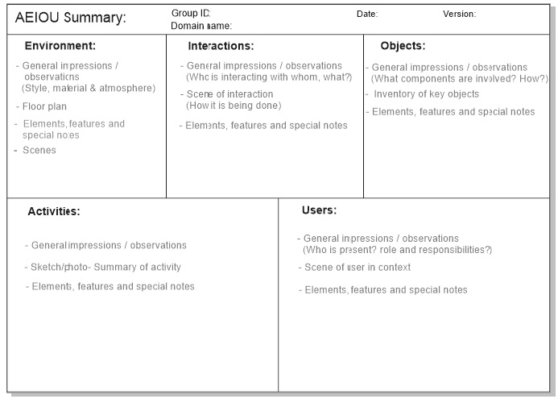

Slide 14

Without understanding - what people see, feel and experience;
Design & Innovation is a pointless task.
“Towards identifying the user’s unarticulated needs”
© 2020 Innodesk Designovation Services. All rights reserved.

Slide 15
Empathy Tools & Frameworks
5W & H: Create questionnaire for different stakeholders
Laddering (Multiple WHYs): for deeper interventions to find root cause
Persona
Customer Journey Map
Empathy Map
Problem Scenario → Problem Statement
© 2020 Innodesk Designovation Services. All rights reserved.

Slide 16
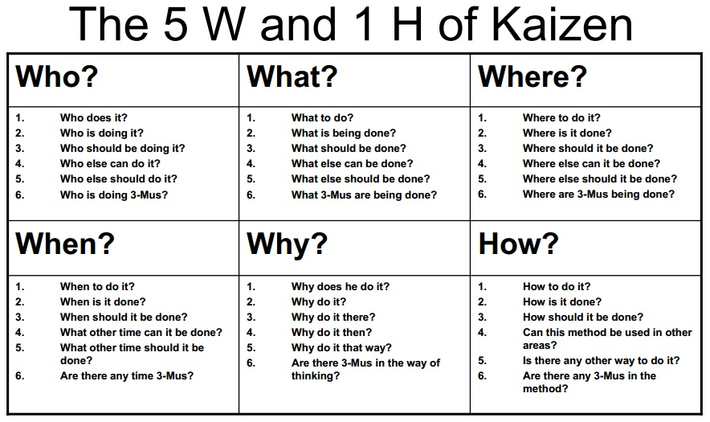
Select a stake holder & create questionnaire for him/her to find various problems/possibilities....You will get different problems/possibilities after interviewing various stakeholders through 5W & H tools.

Slide 17
Create 5W & 1H Questionnaire
Who? | What? | Where?
1. Who is the founder? 2. Who is the investor of your company? 3. Who is your partner in delivery of the products? 4. Who is your CEO? 5. Who is your business adviser? | 1. What is your company’s name? 2. What should be done to increase productivity? 3. What is your aim? 4. What are your working hours/days? 5. What is your future plan regarding your company’s shareholders? | 1. Where is your company located? 2. Where is your manufacturing unit? 3. Where is your head office? 4. Where was the main idea formed? 5. Where should customer contact to get your support?
When? | Why? | How?
1. When was the idea created? 2. When did this idea come to your mind? 3. When did you launch your company world wide? | 1. Why should customers buy from your website? 2. Why should your customers trust regarding your products ? 3. Why do investors invest in your company? 4. Why should customers trust you regarding their privacy? | 1. How does your company work? 2. How many employees are there in your company? 3. How much investment did you gain in total? 4. How many investors invested in your company? 5. How much turnover did your company gain last year?

Slide 18
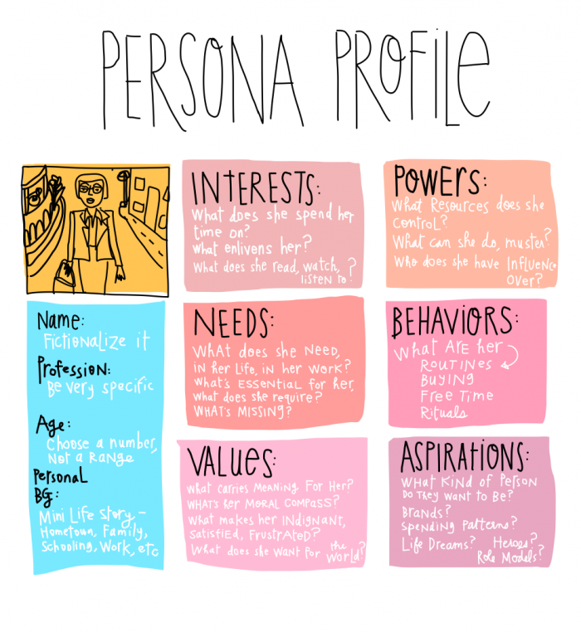
Persona

Slide 19
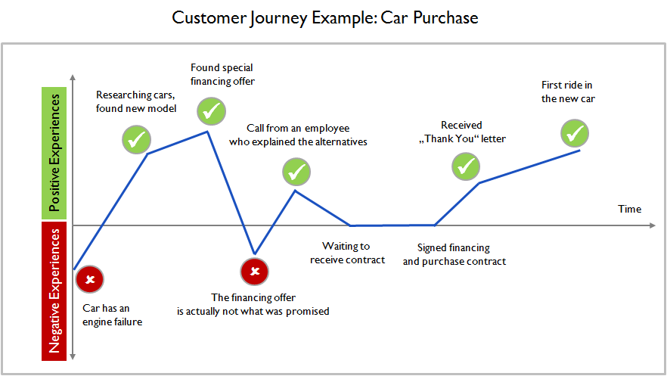
Customer Journey Map

Slide 20
Empathy mapping
Empathy Map helps:
To Empathize User
To Find Emotional/Unarticulated needs of user
Story Telling Through Identification of Happy/Excitement and Sad/Pain moments
Find out insights and problems/possibilities

Slide 21
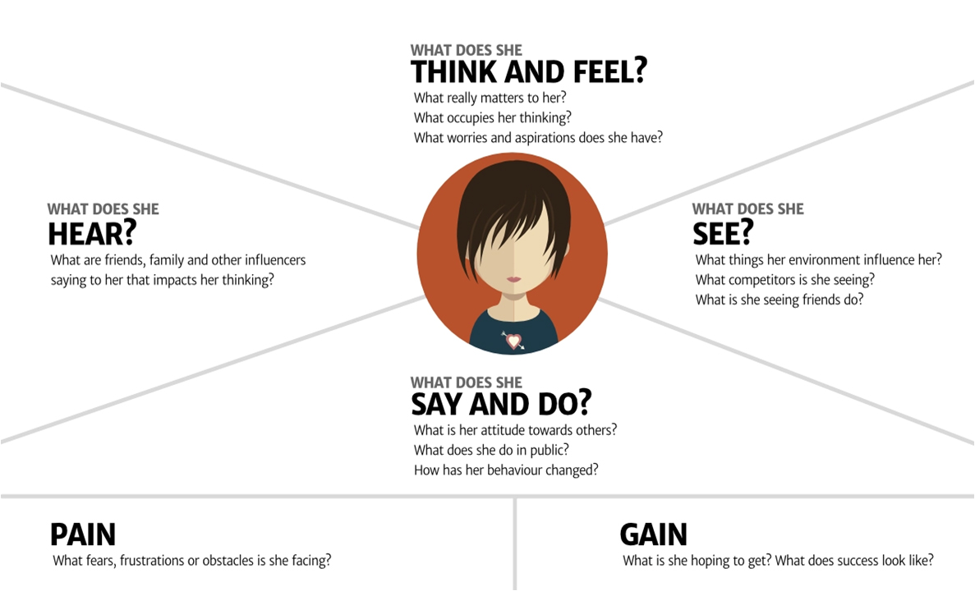

Slide 22
Problem Articulation
User/Stake holder
Problem/Need
Insights
needs a
way to
because
Example.
Persona
Need (Verb)
Insights
Laxman who is a middle aged man with low income
To be more aware of cheaper options for health treatment
He is worried of will he mange such expenses
needs a
way to
because

Slide 23
Field Work deliverables..
(Deadline – 10th September, 2021)
Each team will have primary & secondary research and bring back..
Observation
Stake holder Mapping
Activities
Process-systems
Customer touch points
AEIOU Canvas (60 observations)
5 deep insights (pain/possibility)
Empathy
5W & H questionnaire
2 Persona
2 journey map
3 interview (video/telephonic)
5 deep insights from interview (pain/possibility)
Empathy Canvas

Slide 24






Thank you
innodesk1@gmail.com
91 - 909 909 0464
Follow us on:
/innodeskzone

